Slide 1
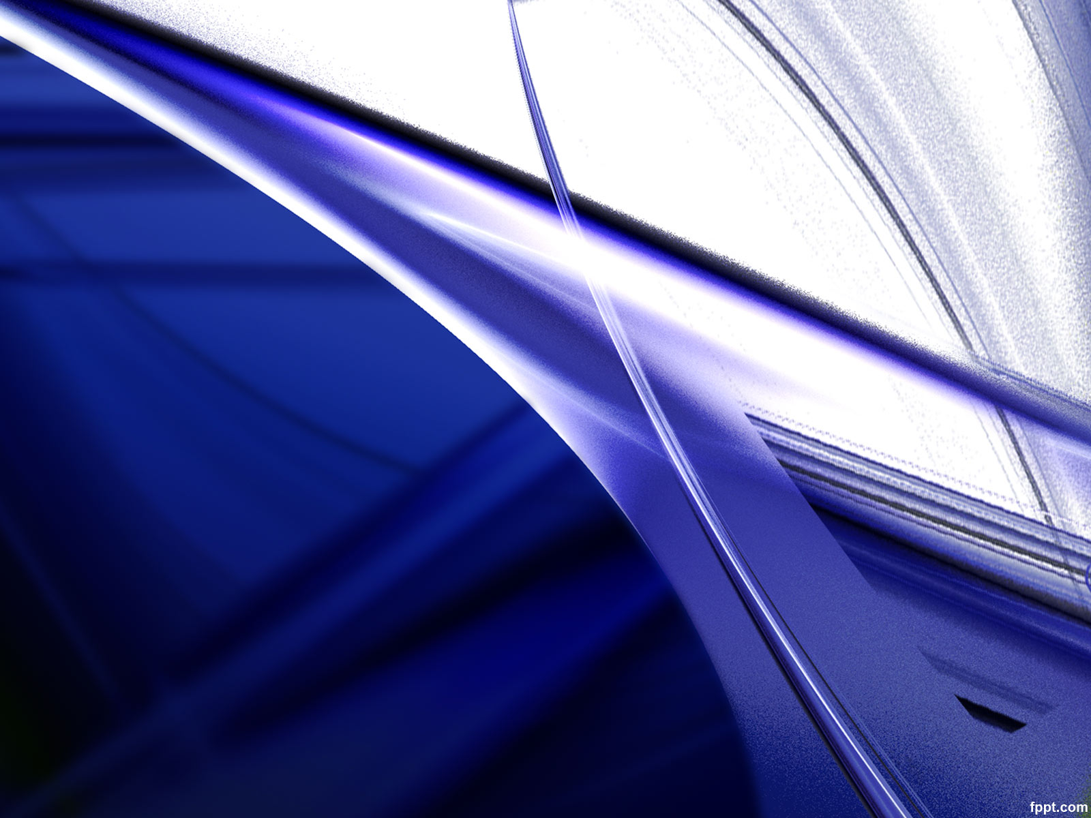
Optical Component of Sensors Mansoor Saleh Mubarak Ba Mahel ID No.: 6218000158
Lenses, Fresnel lenses & Optical fiber

Slide 2
Lenses
Lenses are useful in sensors and detectors to divert the direction of light rays and arrange them in a desirable fashion.
About the lenses:
Lenses are refractive media constructed so that light bends in a particular way.
Notes:
Lenses are useful in sensors and detectors

Slide 3
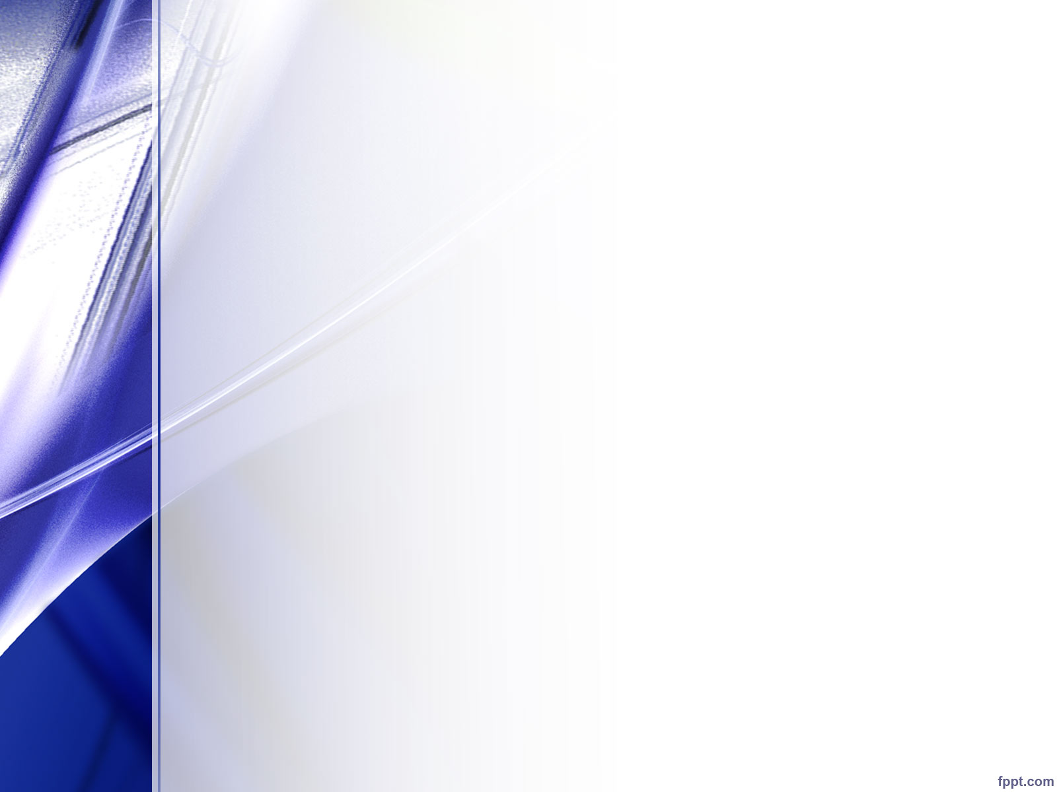
Refraction
Light
Image
Lens
Real
Virtual
Converging
Diverging
Ray
Notes:
Light can move from one meduim to another it can be bend we called it refraction

Slide 4
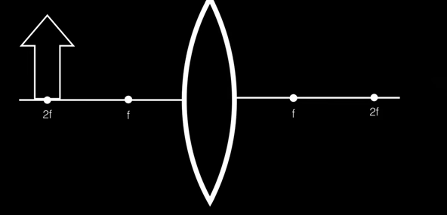
To determine the size and the position of an image created by the lens.
Converting lenses
Parallel
Focal
Parallel
Focal
Real Image

Slide 5
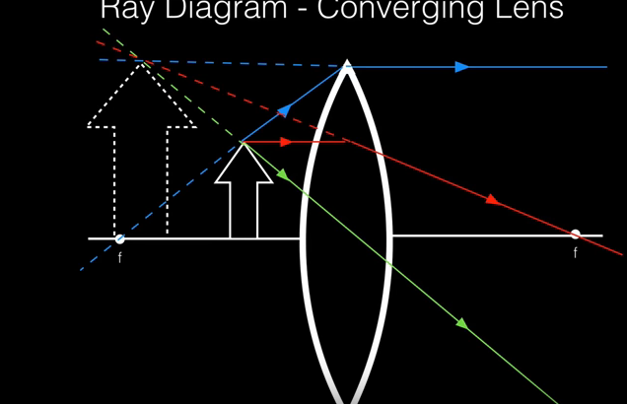
Virtual Image

Slide 6
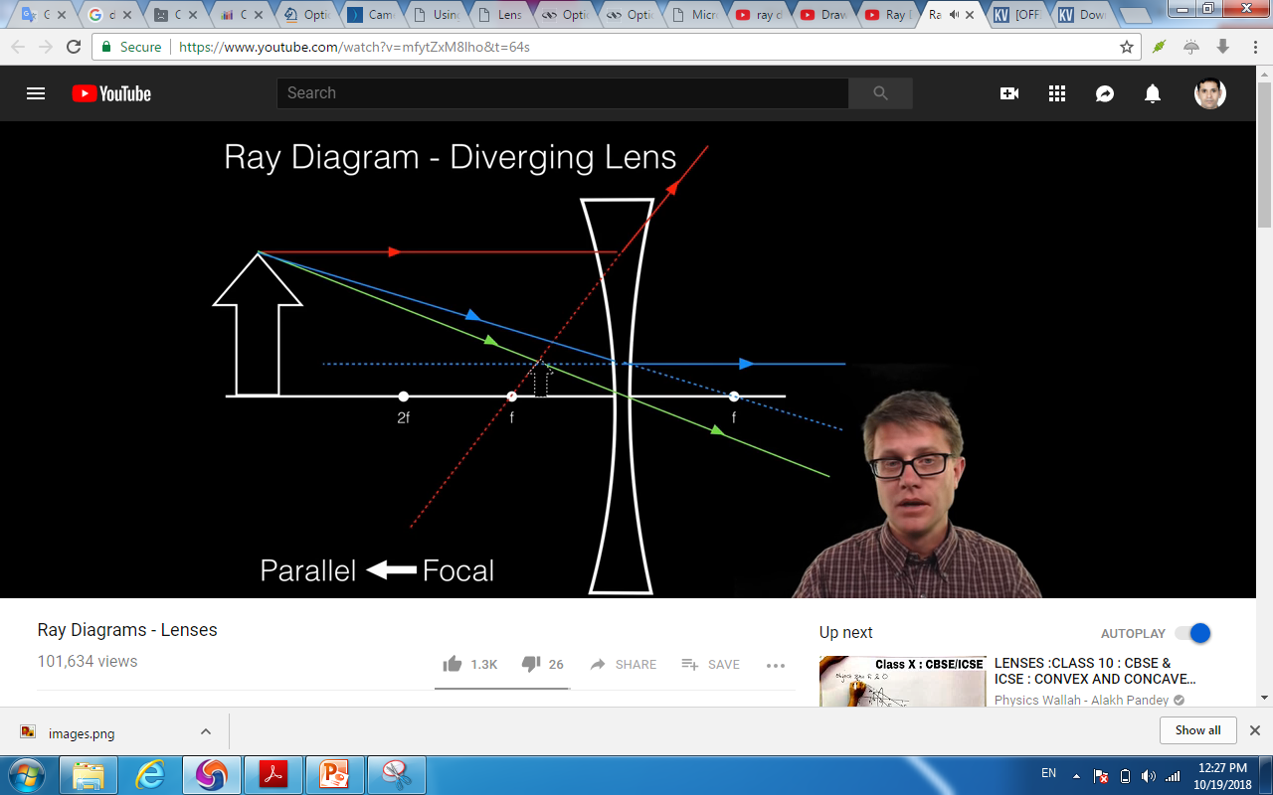
Diverging lenses

Slide 7


Factors in selecting a lens:
Lens focal length. Simply stated, the focal length of a lens is the distance between the lens and the spot where rays are brought to a common point.
In thin lens
has a focal distance f that may be found from the equation
And the image
Image 2F is inverted and positioned at a distance b from the lens. That distance may be found from a thin lens equation
Several lenses may be combined into a more complex system.
Lens diameter. The diameter of the lens determines its light-gathering capability. The larger the lens is, the more light it collects.

Slide 8
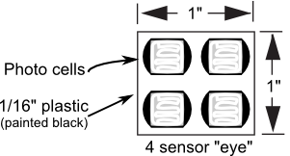
Uses of lenses in sensors
make the robot “see” only the light shining through the lens.
phototransistors
Most phototransistors have the benefit of coming with their own lens already built in. The lens gathers light from straight ahead and focuses it onto the semiconductor element inside.
Even so, phototransistors can still often benefit from an added lens that gathers even more light. A 3/4"-diameter 8- to 10mm focal length lens might gather three to five times the amount of light than using the phototransistor alone would.
You can also use phototransistors instead of photocells. Many phototransistors have built-in lenses, which help focus the light, making the sensors more directional.

Slide 9
Practical Uses For Lenses
You’ve already seen how a lens can gather more light and focus it directly onto a photoresistor or other sensor.
The larger the diameter of the lens, the more light it gathers. Use this to improve the sensitivity of your sensors.
Example: If a sensor is 1/8" and you use a 1" lens in front of it, you have effectively increased the amount of light reaching the sensor by eight times.
Lenses narrow the field of view, limiting the sensor to seeing only straight ahead.
Sensors like photoresistors naturally have a very broad field of view, taking in light from a hemispherical zone in front of it. By using a tube to prevent stray light from striking the cell and adding a lens, the field of vision narrows to just a few degrees, making the sensor much more selective.

Slide 10
Fresnel lenses
Fresnel lenses consist of a series of concentric grooves etched into plastic.
very useful in sensors and detectors where a high quality of focusing is not required and primarily the light energy is prime concern.

Slide 11
About Fresnel lens
The history of Fresnel lenses began in 1748, when Count Buffon proposed grinding out a solid piece of glass lens in steps of the concentric zones in order to reduce the thickness of the lens to a minimum and to lower energy loss.
He realized that only the surface of a lens is needed to refract light,
His idea was modified in 1822 by Augustin Fresnel (1788–1827), who constructed a lens in which the centers of curvature of the different rings receded from the axis according to their distances from the center.

Slide 12
The lens is sliced into several concentric rings.
all rings still remain lenses, which refract incident rays into a common focus defined.
A change in an angle occurs when a ray exits a curved surface, not inside
If all such sections are removed, the lens will look like as it is shown in. b and will fully retain its ability to focus light rays.
all of the rings may be shifted with respect to one another to align their flat surfaces e.g c .A resulting near-flat but grooved lens is called Fresnel, which has nearly the same focusing properties as the original planoconvex lens.

Slide 13
When fabricating a Fresnel lens,
It is difficult to maintain a curved surface of each small groove; hence, the profile of a groove is approximated by a flat surface (a). This demands that the steps be positioned close to each other. In fact, the closer the steps, the more accurate the lens.

Slide 14

A basic formula for computing a Fresnel lens

Slide 15
advantages
low weight, thin size,
ability to be curved (for a plastic lens) to any desirable shape
a lower absorption loss of the light flux. This is the prime reason why this type of a lens is almost has exclusively been used in lighthouses to form parallel beams of light .

Slide 16
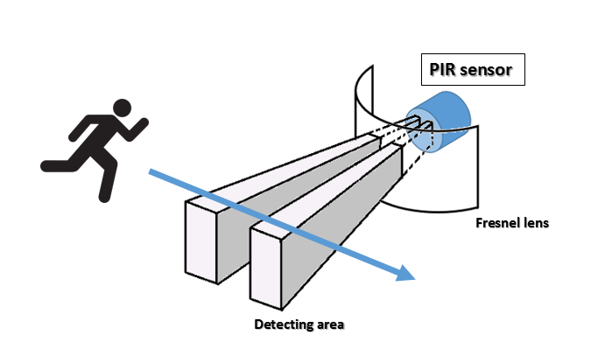
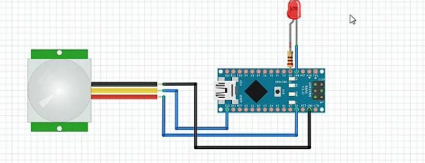
Examples of Frensel lens in sensors PIR sensor

Slide 17
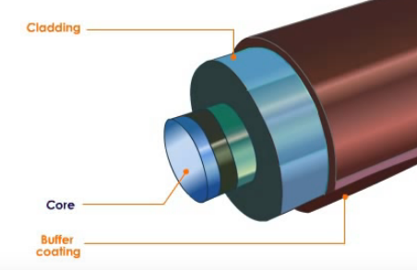
Fiber Optics and Waveguides Construction of Fiber optics

Slide 18
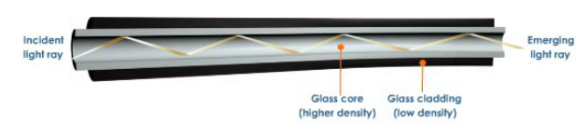
How does optical fiber transmit light
Make use of total internal reflection within the core
The core has higher reflex than the cladding

Slide 19
Total internal reflection
refraction occurs , when a ray incident on the interface between two dielectrics of differing refractive indices. figure 1 (a)
Angle of incidence greater than the critical angle for the pair media

Slide 20
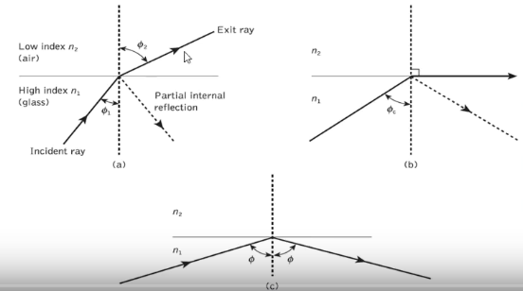

Slide 21

Critical angle
When angle of refraction is 90 and the refracted ray emerges parallel to the interface between the dielectrics. figure 1 (b) .
The values of critical angle is given by

Slide 22
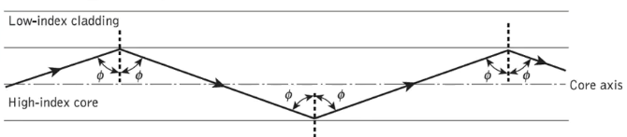
Transmission of a light ray

Slide 23
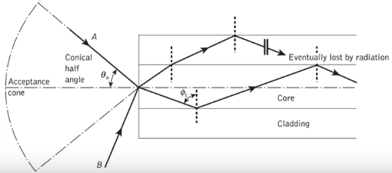
Acceptance angle

Slide 24
Acceptance angle
An array incident into the fiber core at an angle greater than Φ a will be transmitted to the core-cladding interface at an angle less than Φ a and will not be totally internally reflected
Ray B at an angle greater than Φ a is reflected into the cladding and eventually lost.
Thus for ray to be transmitted by total internal reflection they must be incident on fiber core within acceptance cone defined by the conical half angle Φ a.
Hence Φa is the maximum angle which light may enter the fiber in order to be propagated, often referred to the acceptance angle for the fiber

Slide 25
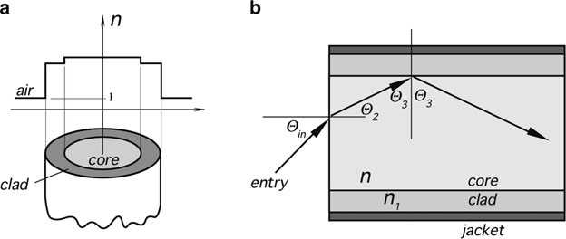
Numeric aperture
important to determine the maximum angle of entry which will result in total internal reflections

Slide 26



minimum angle of an internal reflection Φ0=Φ3, then the maximum angle Φ2 can be found from Snell’s law:
Applying Snell’s law again and remembering that for air n = 1, we arrive at
Combining 1 ,2 , we obtain the largest angle with the normal to the fiber end for which the total internal reflection will occur in the core:

Slide 27
Fiber-optic sensing
Changes in environmental factors have an impact on the propagation characteristics of light in waveguides (intensity, phase, and polarization).
Optical waveguide (mainly fiber) sensing devices on：pressure, stress, strain, displacement, velocity, acceleration, turning, liquid level, flow rate, flow, temperature, voltage, electric current, electric field, magnetic field, gamma-ray chemical composition.
Some of them have been transferred to the production since the 70s.
One of the hot spots in waveguide optics because of the importance of information-access in modern societies.

Slide 28
Thank You

